Slide 1
Insertion Sort

Slide 2
Insertion Sort
A simple sorting algorithm that works by iteratively inserting each element of an unsorted list into its correct position in a sorted portion of the list.
It is a stable sorting algorithm, meaning that elements with equal values maintain their relative order in the sorted output.
Works by building a sorted array one element at a time.
It is considered an “in-place” sorting algorithm, meaning it doesn’t require any additional memory space beyond the original array.

Slide 3
Insertion Sort: Steps
Step 1 − If it is the first element, it is already sorted. return 1;
Step 2 − Pick next element
Step 3 − Compare with all elements in the sorted sub-list
Step 4 − Shift all the elements in the sorted sub-list that is greater than the value to be sorted
Step 5 − Insert the value
Step 6 − Repeat until list is sorted

Slide 4
Insertion Sort: pseudo-code
for j = 2 to A.length
key = A[j]
i = j – 1
while i > 0 and A[i] > key
A[i + 1] = A[i]
i = i -1
A[i + 1] = key

Slide 5
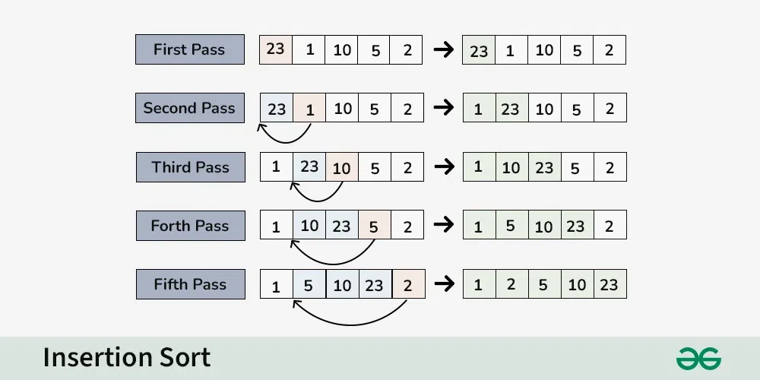
Insertion Sort: Example
Source: Insertion Sort - Data Structure and Algorithm Tutorials - GeeksforGeeks

Slide 6
Insertion Sort: Example
Source: Insertion Sort - Data Structure and Algorithm Tutorials - GeeksforGeeks

Slide 7
Insertion Sort: Example
Source: Insertion Sort - Data Structure and Algorithm Tutorials - GeeksforGeeks

Slide 8
Insertion Sort: Example
Source: Insertion Sort - Data Structure and Algorithm Tutorials - GeeksforGeeks

Slide 9
Insertion Sort: Example
Source: Insertion Sort - Data Structure and Algorithm Tutorials - GeeksforGeeks

Slide 10
Insertion Sort: C++ Code
void insertionSort(int arr[], int n)
{
int i, key, j;
for (i = 1; i < n; i++) {
key = arr[i];
j = i - 1;
// Move elements of arr[0..i-1],
// that are greater than key,
// to one position ahead of their
// current position
while (j >= 0 && arr[j] > key) {
arr[j + 1] = arr[j];
j = j - 1;
}
arr[j + 1] = key;
}
}
Source: Insertion Sort - Data Structure and Algorithm Tutorials - GeeksforGeeks

Slide 11
Insertion Sort: Time complexity
Best case: O(n), If the list is already sorted, where n is the number of elements in the list.
Average case: O(n²), If the list is randomly ordered
Worst case: O(n²), If the list is in reverse order
Source: Insertion Sort - Data Structure and Algorithm Tutorials - GeeksforGeeks

Slide 12
Insertion Sort: Advantages and Disadvantages
Advantages
Simple and easy to implement.
Stable sorting algorithm.
Efficient for small lists and nearly sorted lists.
Space-efficient.
Disadvantages
Inefficient for large lists.
Not as efficient as other sorting algorithms (e.g., merge sort, quick sort) for most cases.

Slide 13
Insertion Sort: Video
Insertion sort in 2 minutes (youtube.com)

